Slide 1
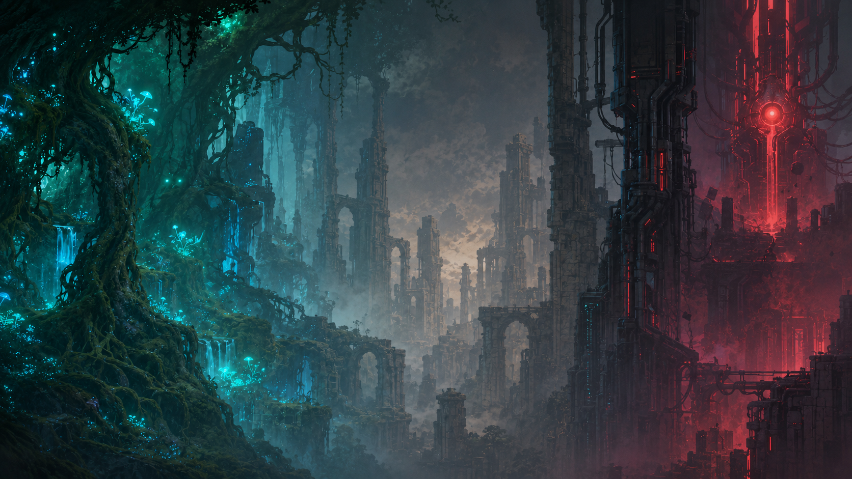
SHIFTBREAKER
GAME DESIGN DOCUMENT
A 2D momentum puzzle platformer
Participant: Yash Gupta
Age: 9
Game Design Competition Submission

Slide 2
Game Design
A platformer built around choosing the right form at the right time
The player controls the last Shifter while escaping the Null Engine.
Experience goal: make platforming feel like a puzzle instead of a test of button speed.
The game teaches its rules through short challenges and clear visual clues.
Players learn to preserve momentum while transforming, which creates satisfying combinations.
The world combines overgrown ruins with the red Null Engine.

Slide 3
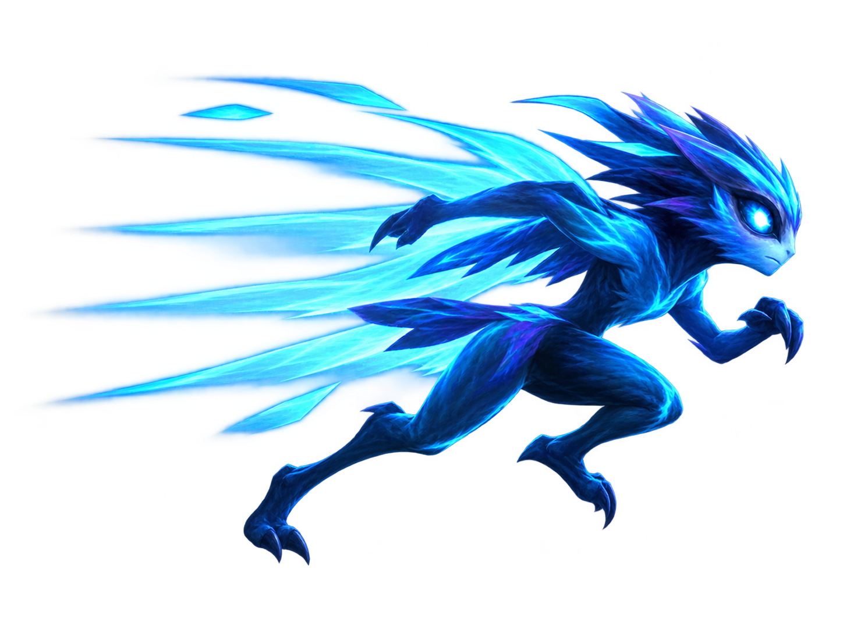
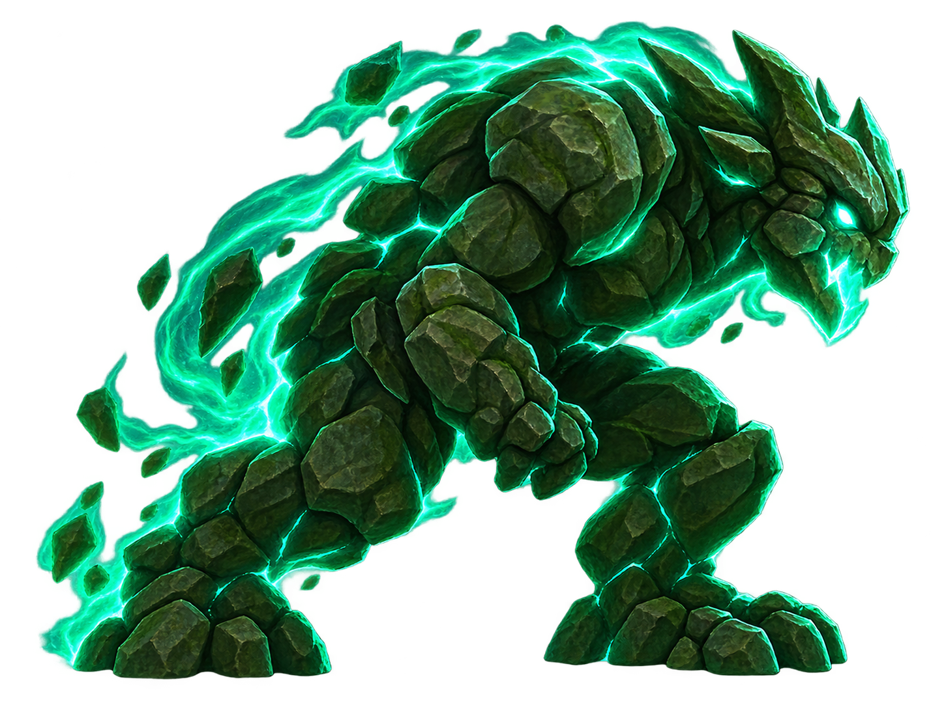
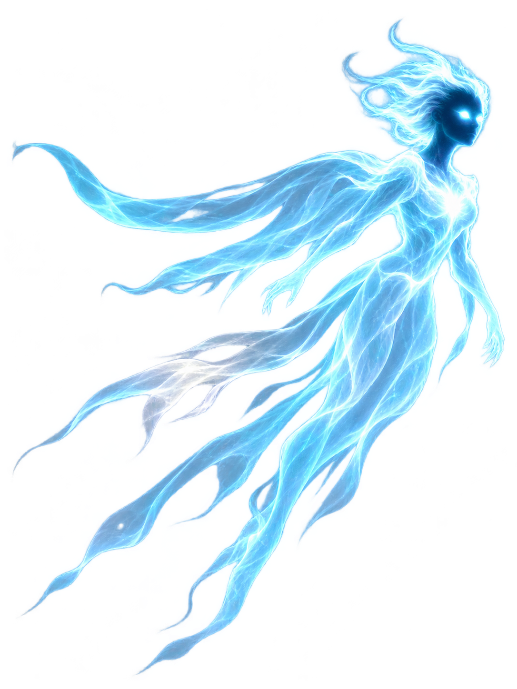
Gameplay Description
Three forms create the platforming choices
SWIFT
TITAN
SKY
Fast movement, dash, and double jump. Builds momentum for Impact and Soar Shifts.
Breaks barriers, holds pressure plates, and performs a Ground Slam.
Glides, flies upward, and uses Air Pulse to control machine hazards.
Signature combinations: Swift to Titan = Impact Shift | Swift to Sky = Soar Shift | Sky to Titan = Meteor Shift

Slide 4
Six-Level Progression
Each level introduces a different reason to transform
1
Awakening
2
Overgrowth
Learn forms and break the first wall
Cross the Soar Ravine
3
The Ruins
4
Shattered Machine
Collect three Energy Cores and restore the lift
Disable lasers and time machine hazards
5
The Null
6
The Core
Wake, trick, and fight the copying enemy
Break the Core Barrier and defeat the stabilizers

Slide 5
Key Design Decisions
Decisions that keep the game understandable and challenging
Momentum shifts
Transformations keep movement speed, so players can solve obstacles with timing.
Clear color language
Blue signals movement, green signals heavy actions, cyan signals air, and red signals danger.
Fast checkpoints
Players return quickly to a safe place after mistakes.
The Null as a puzzle
The enemy copies earlier player forms, so players can deliberately use its Titan form.
Energy limits
Shifter Energy stops players from changing form without thinking.

Slide 6
Development Process and Improvements
The project improved through repeated testing and adjustment
Concept
Defined a 2D platformer where forms solve different kinds of obstacles.
Prototype
Built movement, jumping, form shifting, platforms, hazards, and the first level.
Iteration
Added six distinct level goals, moving-platform carry, checkpoints, quests, coins, and the Null puzzle.
Polish
Improved the HUD, transformation effects, health rules, energy rules, feedback, sound, and music.

Slide 7
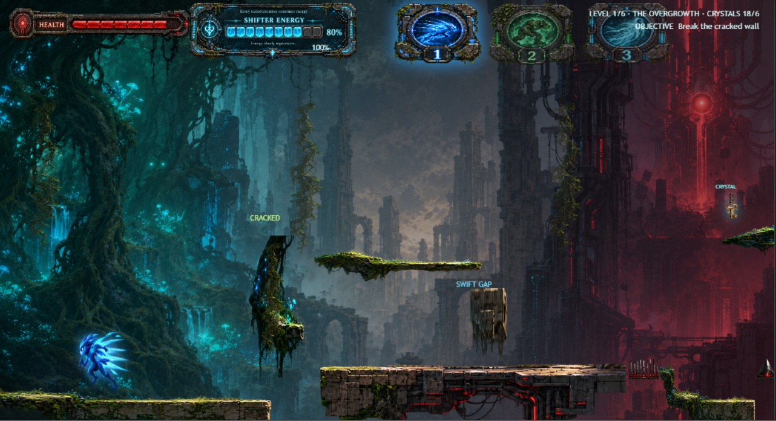
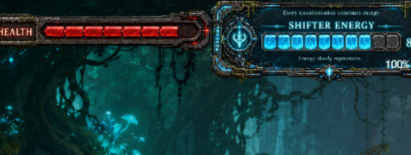
Gameplay Screenshots
Examples of the level view and the live HUD
Live HUD
Health and Shifter Energy change during play. Form icons show the currently selected form.
Gameplay view
The player moves through platforms, gaps, hazards, a cracked wall, and collectible objectives.
Notes:
Images: local screenshots supplied by the student during development.

Slide 8
AI Usage Disclosure
A clear record of how AI supported the project
AI tools were used during development.
The student remained responsible for the game concept, art selection, level decisions, testing, feedback, and final approval.
AI tool used | Purpose of use | AI-generated output | Student contribution or modification
Codex | Code organization, debugging help | Code suggestions, structural edits | Shift-breaker was designed and developed by me. I created the game idea, chose the art style, planned the levels, decided the gameplay rules, tested the game, and gave feedback to improve it. I used AI as a helper for coding support, organizing files, fixing bugs, and suggesting ways to improve features. I reviewed, selected, changed, and tested all AI-assisted work myself.

Slide 9
Game Link
Shiftbreaker

